Slide 1

Air Quality Forecasting (Co2 Emission)
Team members
1.) ANISH
2.) ABIJITH SURESH

Slide 2
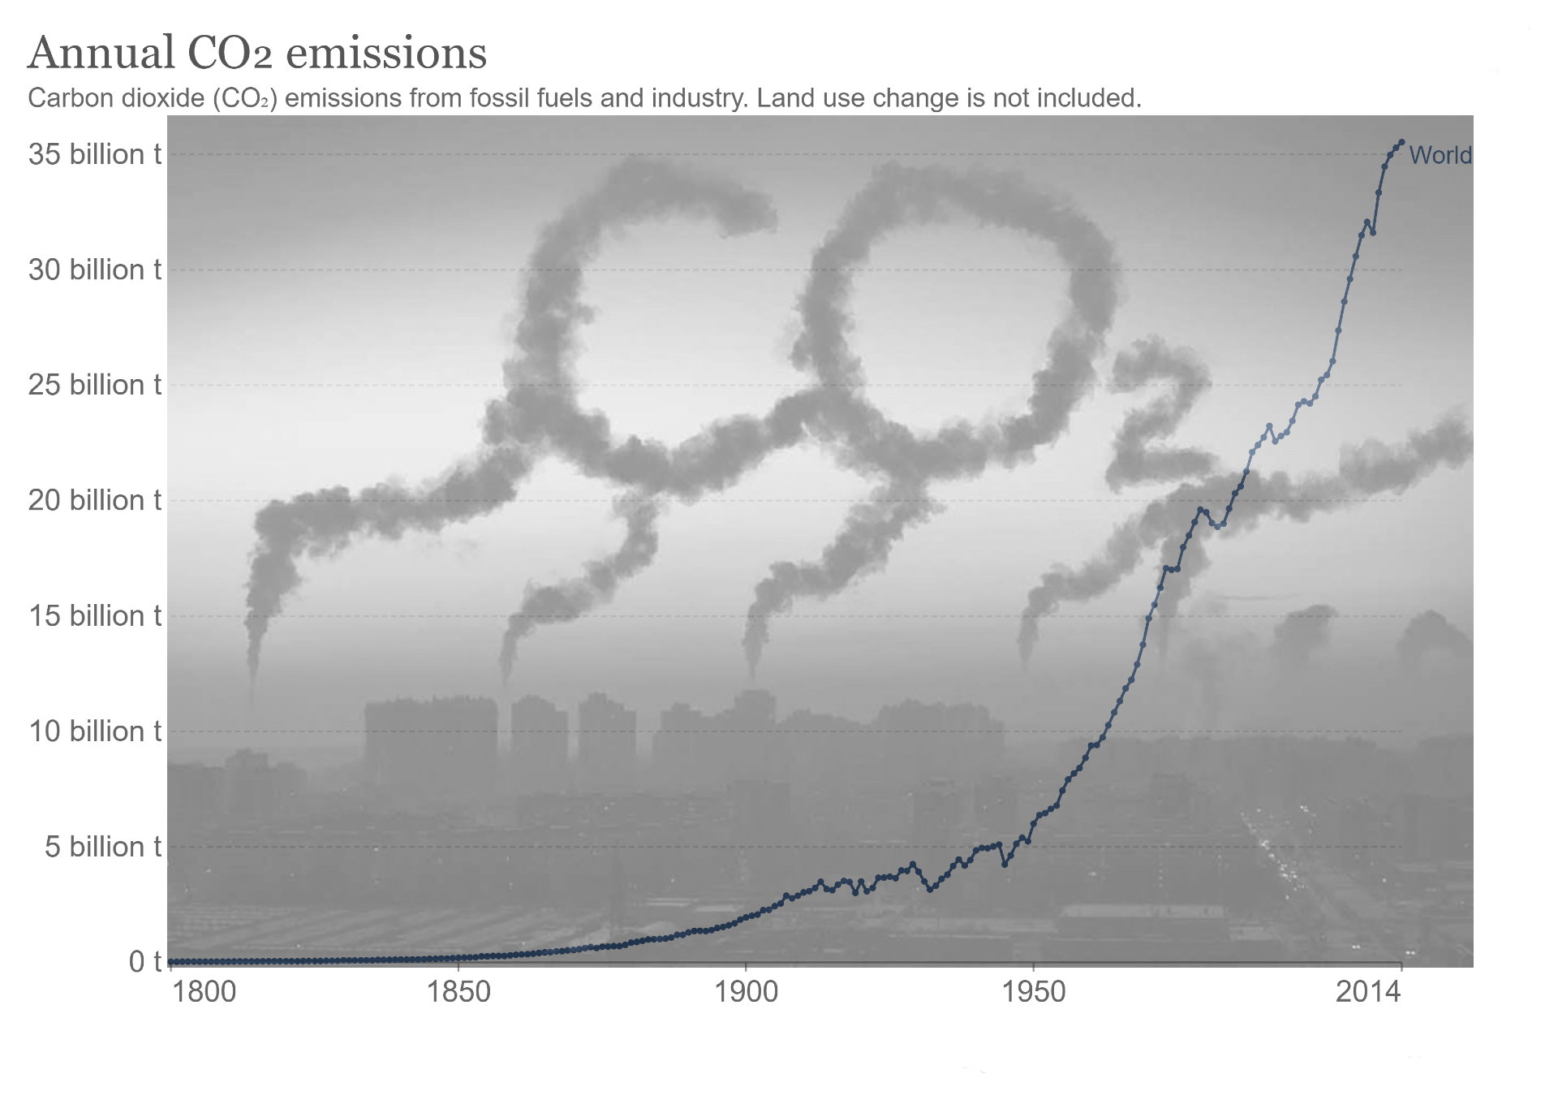
Business objective
To Forecast CO2 levels for an organization so that the organization can follow government norms with respects to CO2 emission levels.

Slide 3
Introduction
There is wide consensus among scientists and policymakers that global warming as defined by the Intergovernmental Panel on Climate Change (IPCC) should be pegged at 1.5 Celsius above the pre-industrial level of warming in order to maintain environmental sustainability . The threats and risks of climate change have been evident in the form of various extreme climate events, such as tsunamis, glacier melting, rising sea levels, and heating up of the atmospheric temperature. Emissions of greenhouse gases, such as carbon dioxide (CO2) are the main cause of global warming.
In this Project for Time Series Analysis and Forecasting
Each step taken like EDA, Feature Engineering, Model Building, Model Evaluation and Prediction table, and Deployment. Explaining which model to select on basis of metrics like RMSE, MAPE and MAE value for each model. Finally explaining which model we will use for Forecasting.
Better accuracy in short-term forecasting is required for intermediate planning for the target to reduce CO2 emissions. High stake climate change conventions need accurate predictions of the future emission growth path of the participating organization to make informed decisions. Exponential techniques, Linear statistical modeling and Autoregressive models are used to forecast the emissions and the best model will be selected on these basis
1.) Minimum error
2.) Low bias and low variance trade off

Slide 4
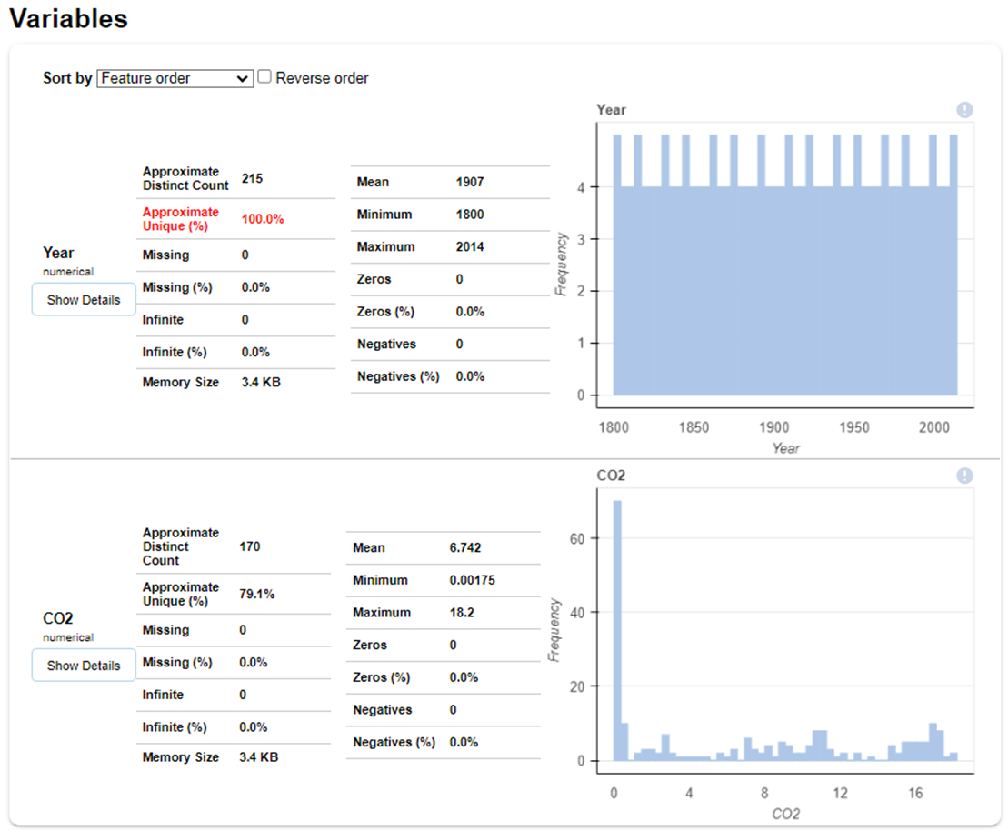
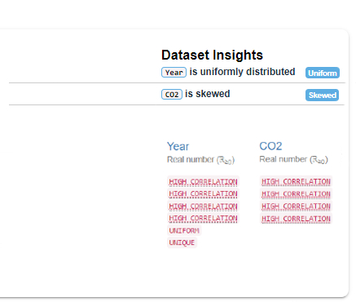
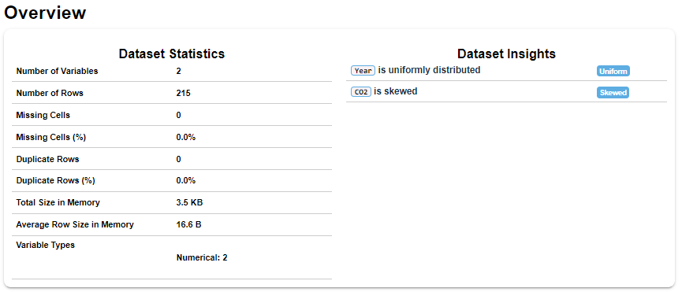
Dataset details

Slide 5
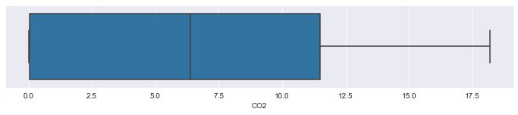
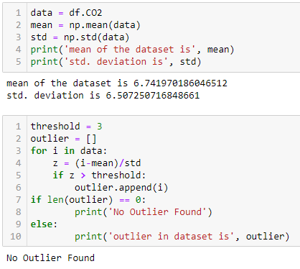
OUTLIER DETECTION
Observation:
There are no outliers above the positive upper extreme whisker.
There are no outliers below the negative side of the lower whisker
The data looks right skewed which means there are extreme values that do not follow the regular trend of the data

Slide 6
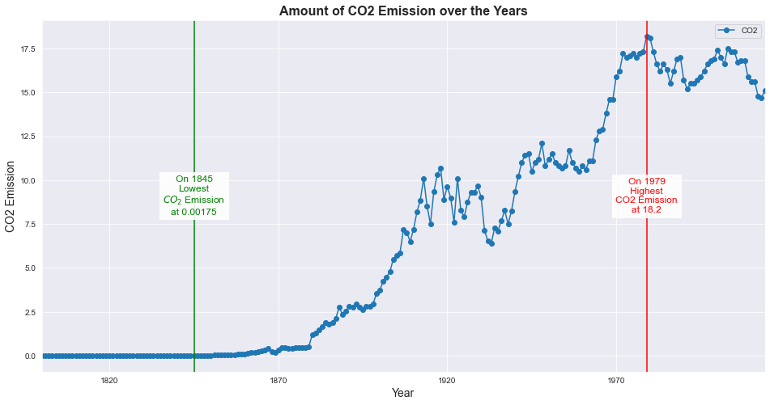
Data visualization
There has been a significant increase in the amount of ‘CO2’ emission after ‘1870’.
With increasing time the amount of emission of ‘CO2’ is also increasing.
The lowest ‘CO2’ emission recorded was ‘0.00175’ on ‘1845’
The highest ‘CO2’ that was recorded ‘18.2’ on ‘1979’
We can see there was an plateau
in ‘CO2’ Emission from ‘1800’ to ‘1860’ not much of a variance, mostly constant.
Observation: As we can observe that approximately after ‘1845’ there is a increase in the amount of ‘CO2’ Emission and at ‘1979’ it was at its peak.

Slide 7
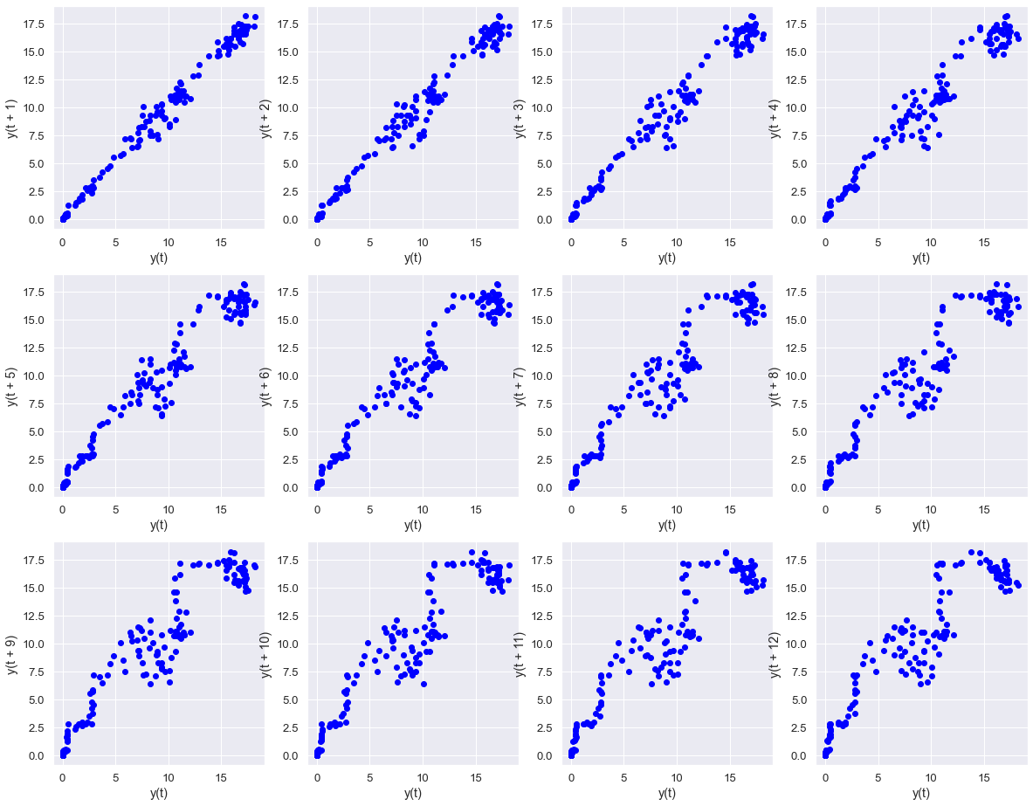
Data visualization
Lag plots (yearly)
A lag plot is a special type of scatter plot in which the X-axis represents the dataset with some time units behind or ahead as compared to the Y-axis. The difference between these time units is called lag or lagged and it is represented by k.
Observation: Our data is linear mostly linear and it shows positive autocorrelation with the previous lag values and it has an underlying structure of and autoregressive model.

Slide 8
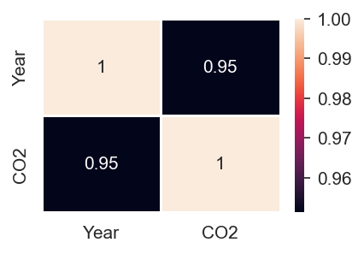
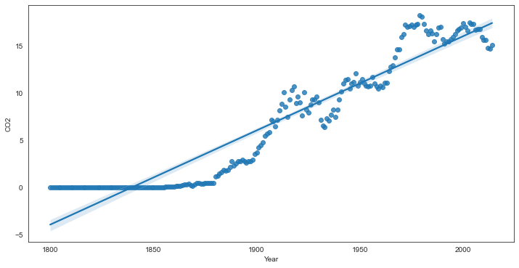
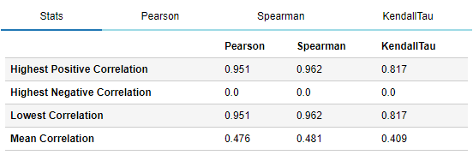
CORRELATION OF THE DATASET
Observation:
There is a positive linear correlation between the independent feature ‘Year’ and the dependent feature ‘CO2’.

Slide 9
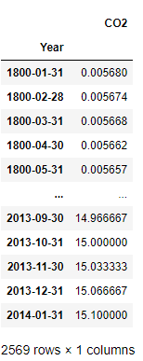
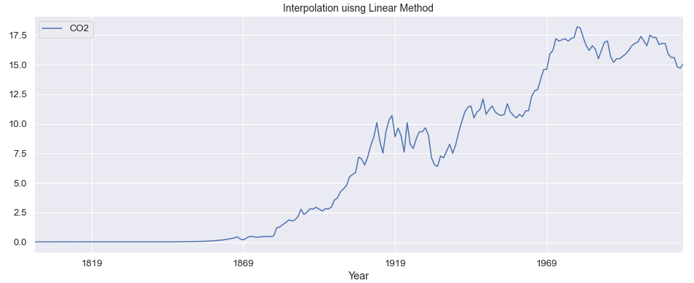
Sampling Yearly into Monthly time series
Interpolation method
Using ‘linear’: You draw a straight line joining the next and previous points of the missing values in the data.

Slide 10
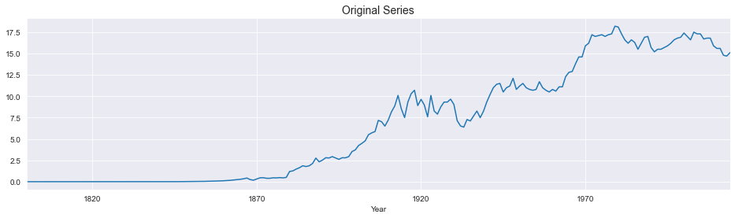
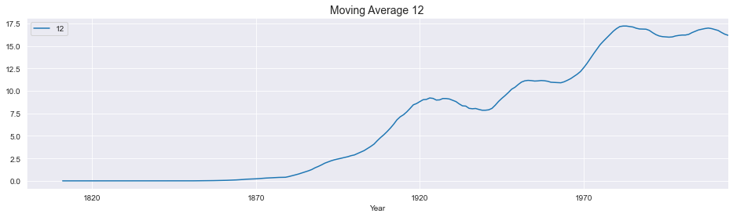
Moving Average

Slide 11
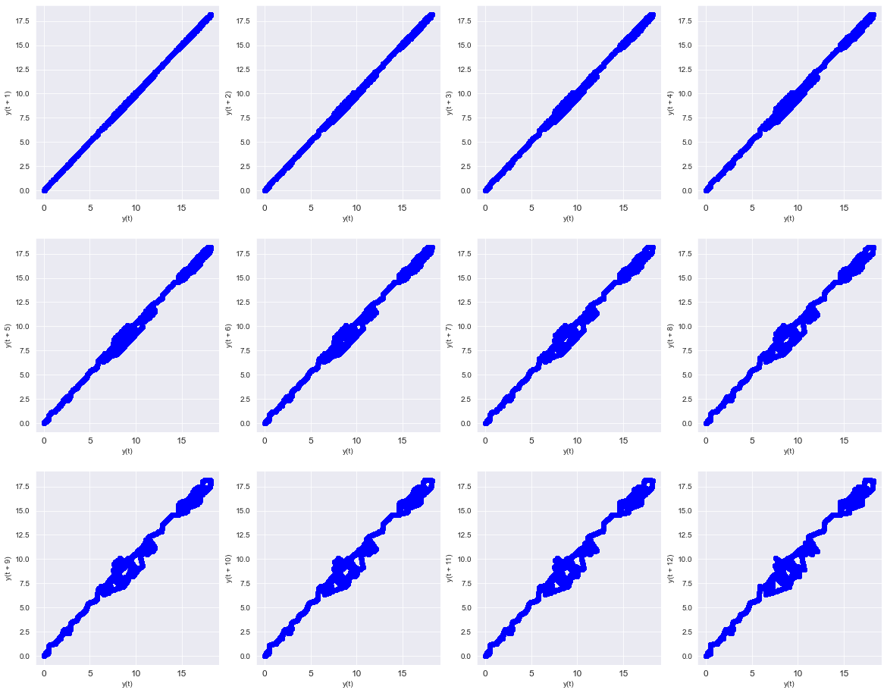
Data visualization
Lag plots (Monthly)
Observation: Our data shows positive linear autocorrelation with the previous lag values (previous months)

Slide 12
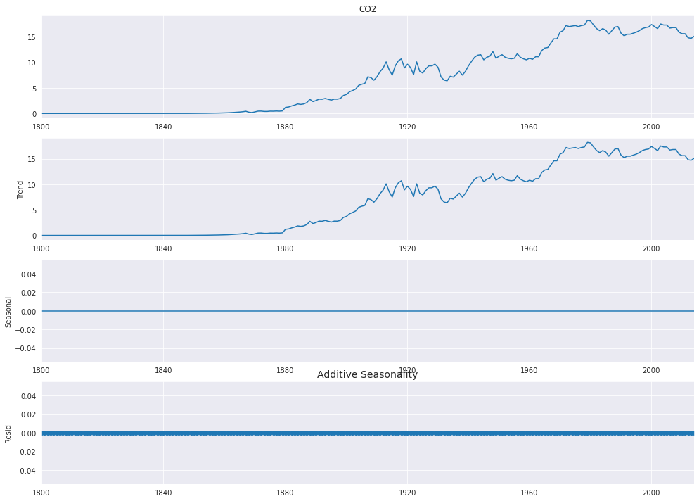
Time series decomposition plot
Observation:-
Observed - Actual data
2. Trend - Increasing trend.
3. Seasonal-
- Does not Varies with the mean 0.
- No seasonality found.
4. Residual - It is the noise pattern of the time series data for each year, which was not captured by the two components - Trend and Seasonality. Residual is the left over after decomposition of the two major components (Trend and Seasonality)

Slide 13
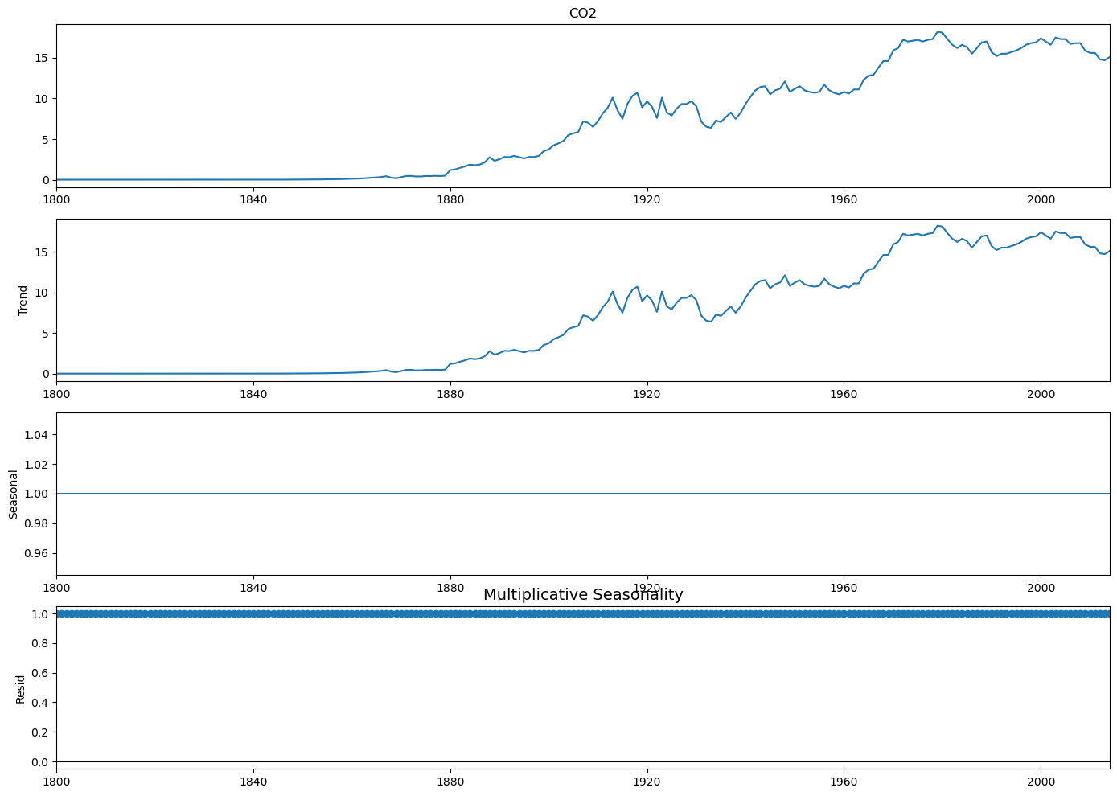
Time series decomposition plot
Observation:-
Observed - Actual data
2. Trend - Increasing trend.
3. Seasonal-
- Does not Varies with the mean 0.
- No seasonality found.
4. Residual - It is the noise pattern of the time series data for each year, which was not captured by the two components - Trend and Seasonality. Residual is the left over after decomposition of the two major components (Trend and Seasonality)

Slide 14
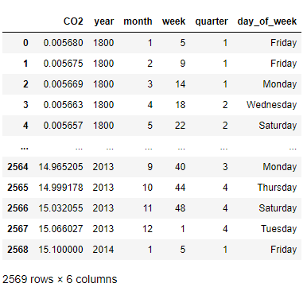
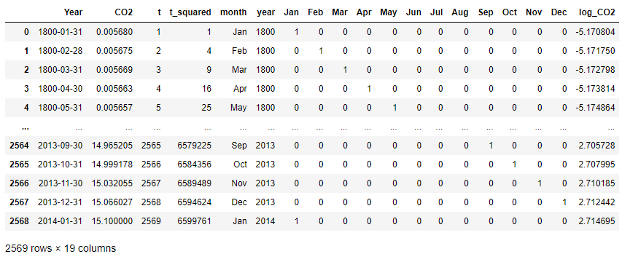
Feature Engineering Feature Extraction
Feature Extraction for Visualization
Data Pre-processing for Model Driven Techniques

Slide 15
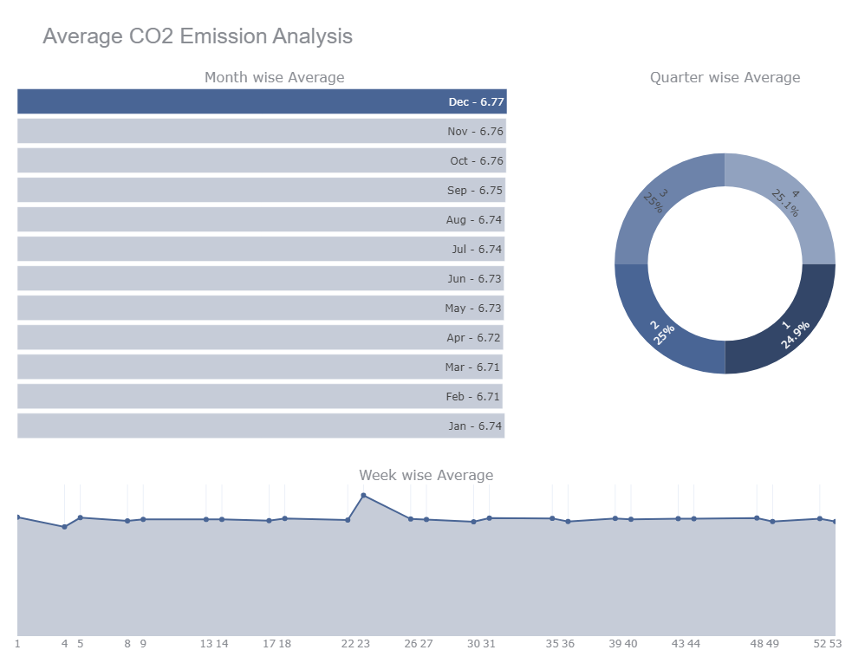
Data visualization
Observation: As we can observe there is Weekly seasonality in our time series data analysis.
Every 23rd week of every Year we can see a spike in CO2 emission in our time series
It does not have Quarterly or Monthly seasonality through out the years.

Slide 16
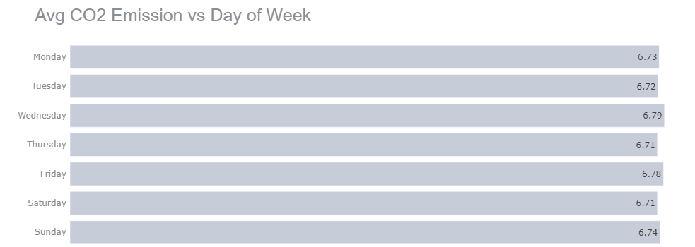
Data visualization
Observation: In daily analysis of 𝐶𝑂2 emission we are getting a constant variation among all days throughout the Years.
Hence, we can see there is no Daily seasonality or pattern in CO2 emission

Slide 17
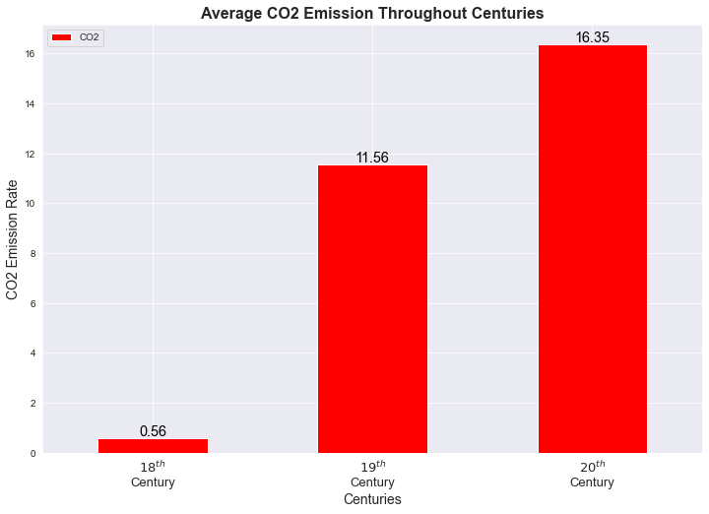
Data visualization

Slide 18
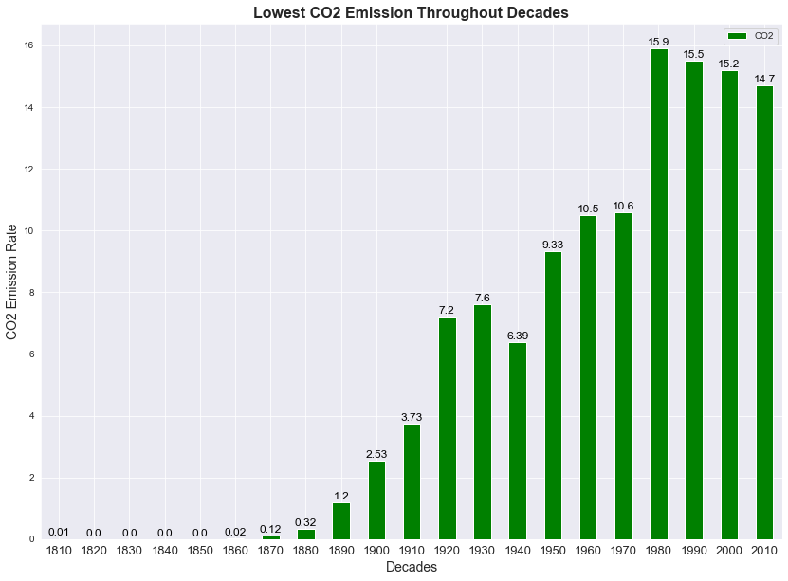
Data visualization

Slide 19
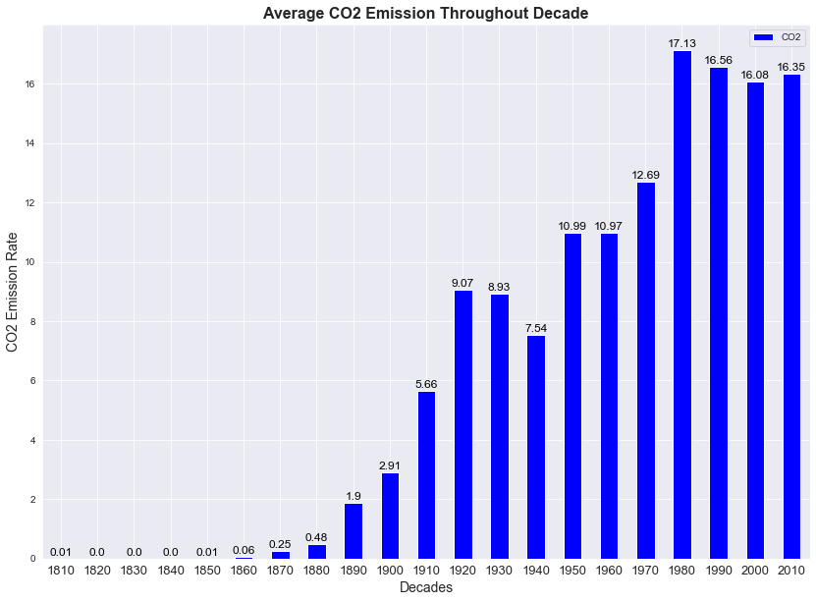
Data visualization

Slide 20
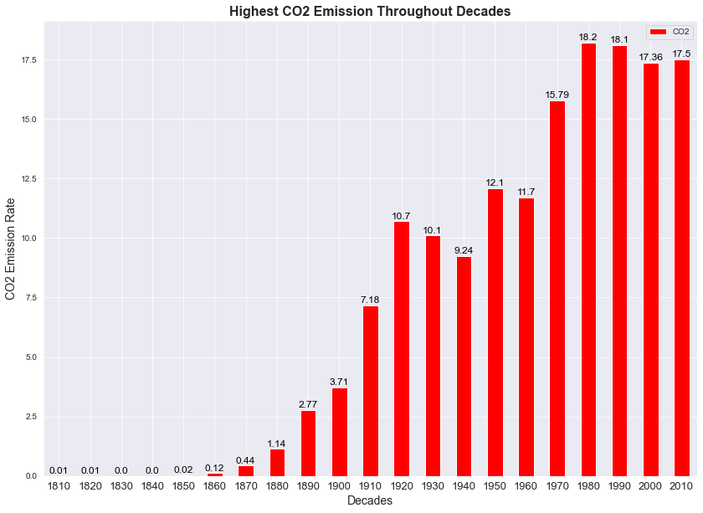
Data visualization

Slide 21
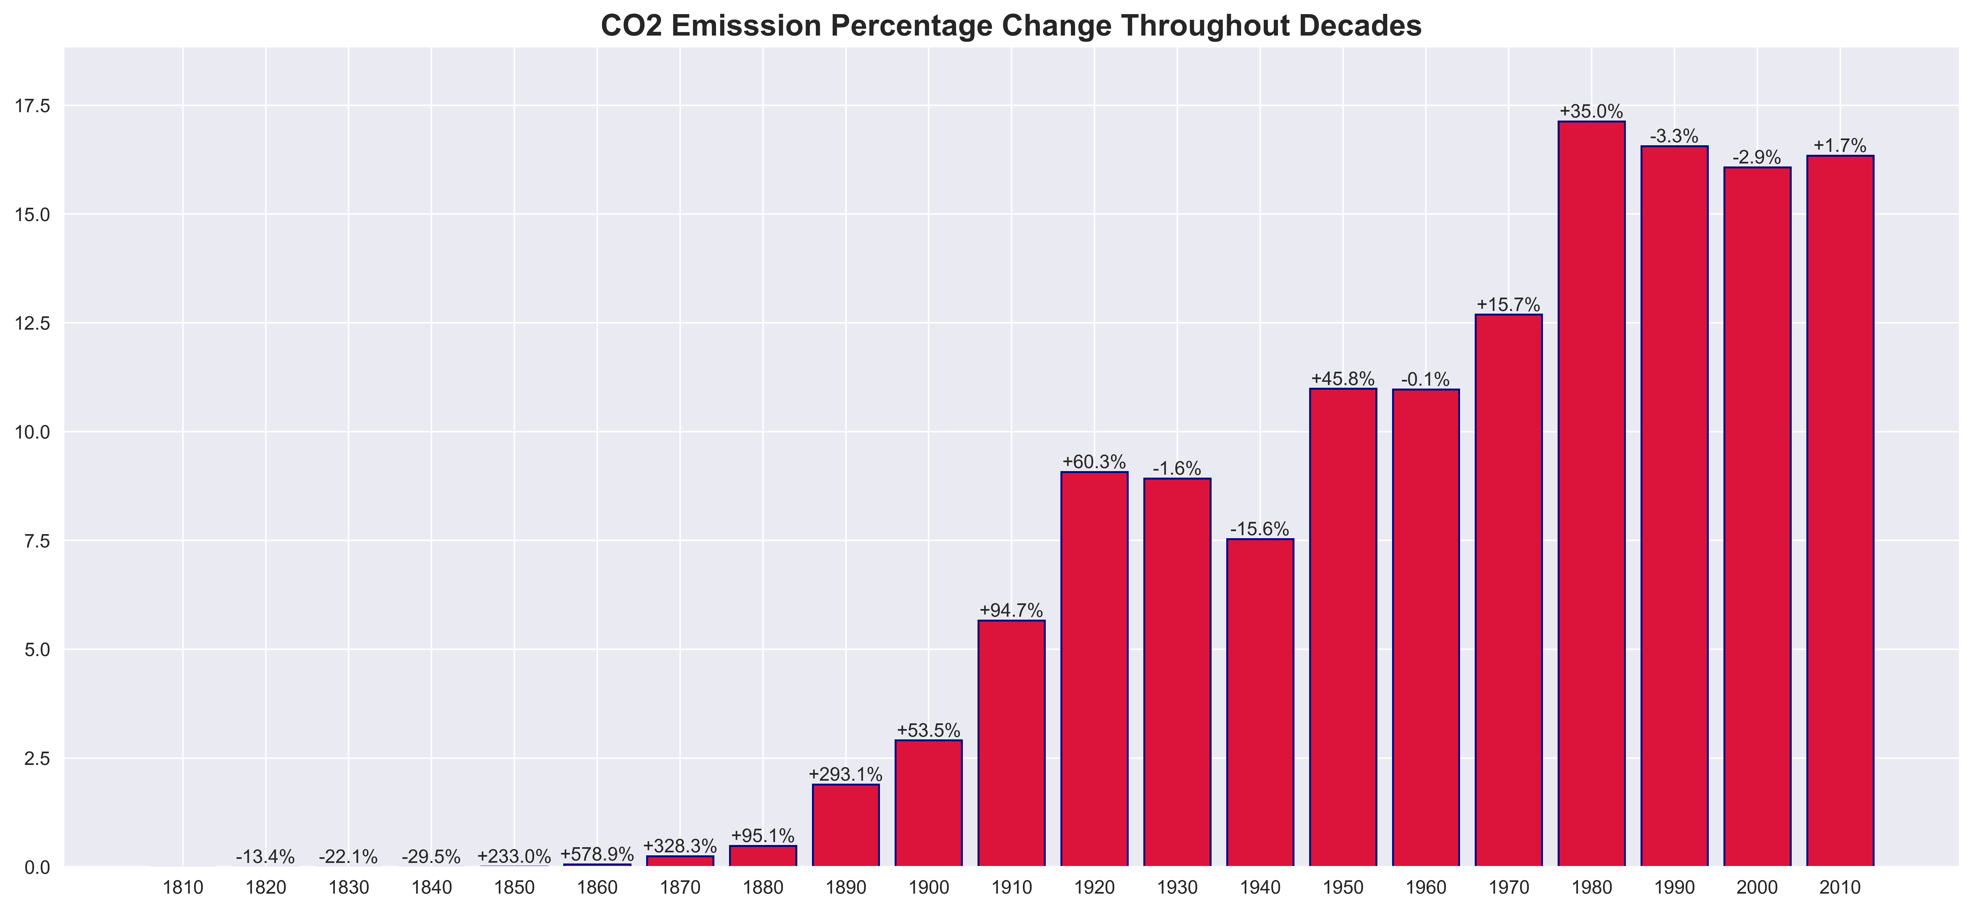
Data visualization

Slide 22
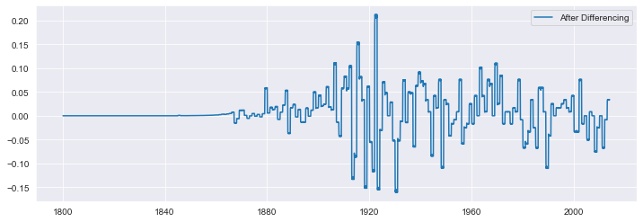
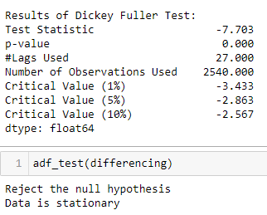
Test of Stationarity Converting Non-Stationary Time Series into Stationary
Assumptions of ARMA model
Data should be stationary – by stationary it means that the properties of the series doesn’t depend on the time when it is captured. A white noise series and series with cyclic behavior can also be considered as stationary series.
Data should be univariate – ARMA works on a single variable. Auto-regression is all about regression with the past values.
Augmented Dicky Fuller Test
Null Hypothesis (H0): The series is not stationary
p-value > 0.05
Alternate Hypothesis (H1): The series is stationary
p-value <= 0.05
Differencing
In this method, we compute the difference of consecutive terms in the series. Differencing is typically performed to get rid of the varying mean. Mathematically, differencing can be written as:
yt‘ = yt – y(t-1)
where yt is the value at a time t
Applying differencing on our series and plotting the results:
First Order Differencing {yt = yt – y(t-1)}
Observation: Finally our data is stationary as our p-value is less then 0.05 we can reject Null Hypothesis.
Hence, state our time series is stationary which means it does not have any trend and seasonality. The data does not depend on the time when it is captured.

Slide 23
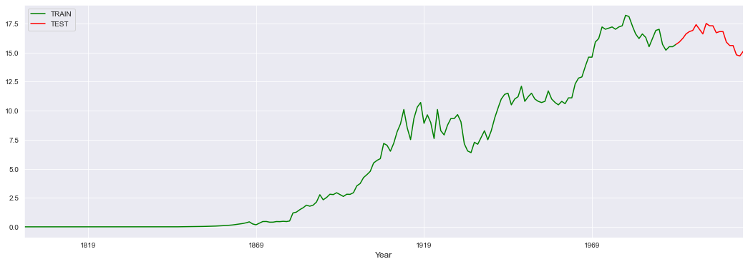
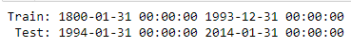
Splitting the Raw data into train test split
No random partition That’s because the order sequence of the time series should be intact in order to use it for forecasting.
Leaving Test Data with 5 Years of Time Series
For training and testing We are going to forecast for the last 5 years. that is from 1994 to 2014.

Slide 24
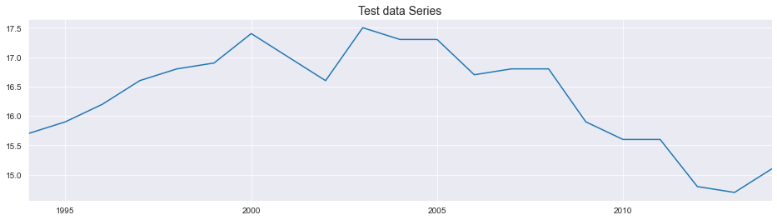
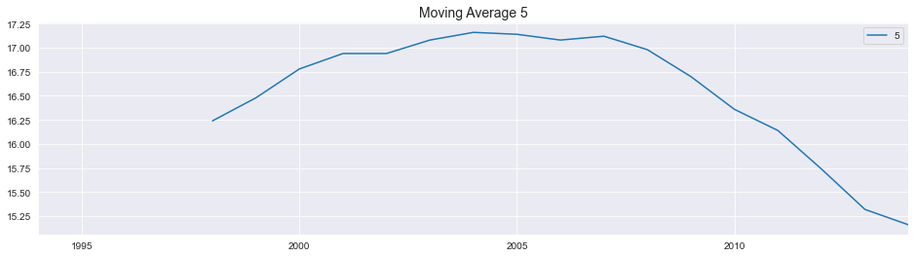
Test Data Moving Average Plot

Slide 25
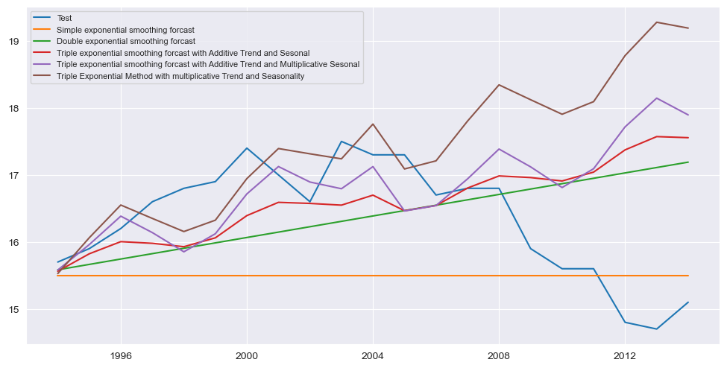
MODEL BUILDING on Raw Data (Yearly Data)

Slide 26
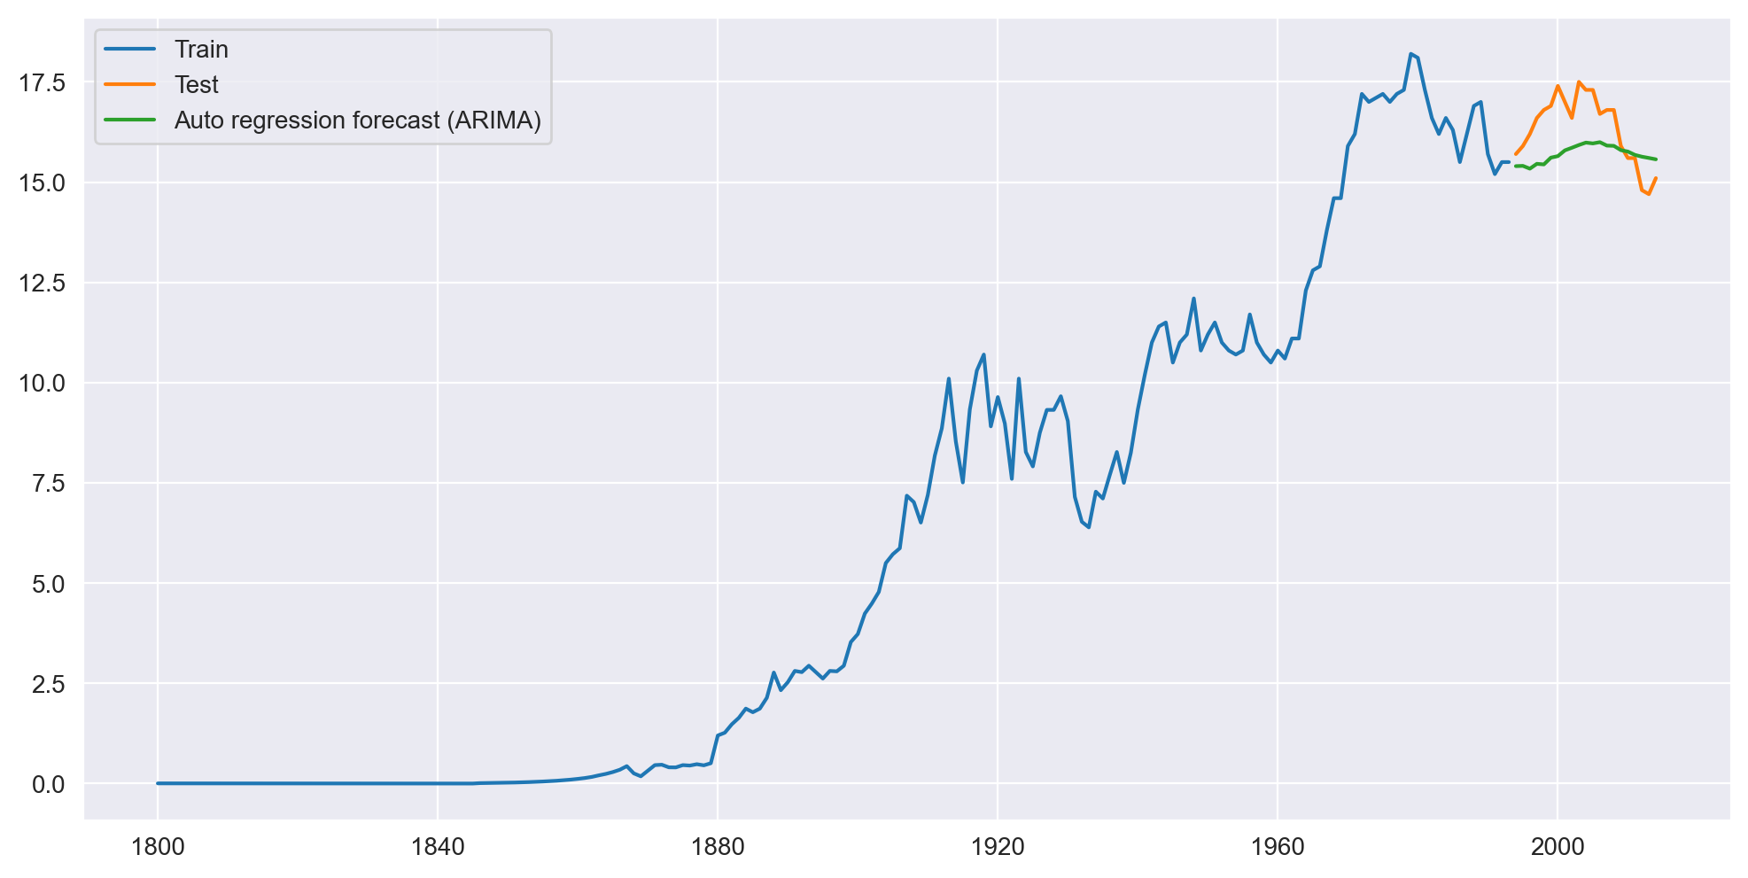
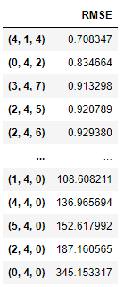
ARIMA Model Building on (Yearly Data)
ARIMA Hyperparameter Tuning order(p,d,q)
p = Periods to lag for eg: (if P= 4 then we will use the four previous periods of our time series in the autoregressive portion of the calculation) d = In an ARIMA model we transform a time series into stationary one(series without trend or seasonality) using differencing. D refers to the number of differencing transformations required by the time series to get stationary.
q = This variable denotes the lag of the error component, where error component is a part of the time series not explained by trend or seasonality.

Slide 27
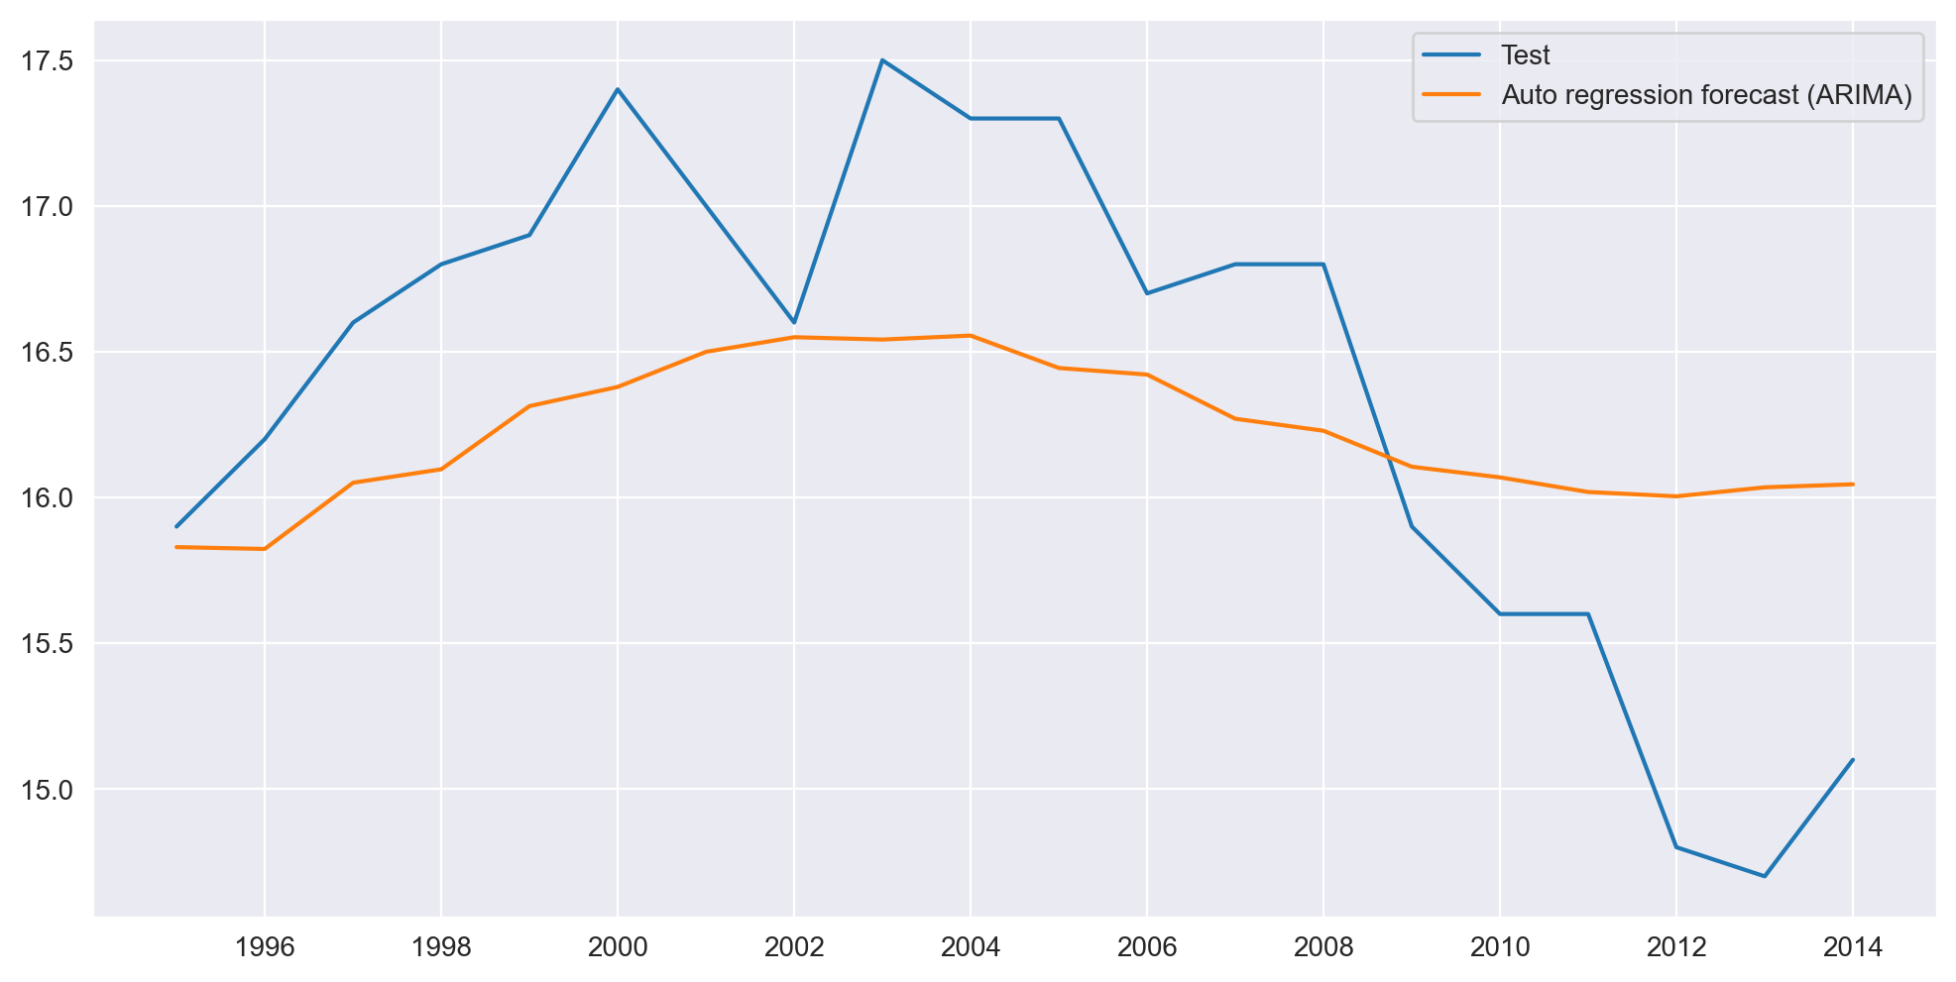
ARIMA Model Building on (Yearly Data)
Test Data vs Forecasted Data

Slide 28
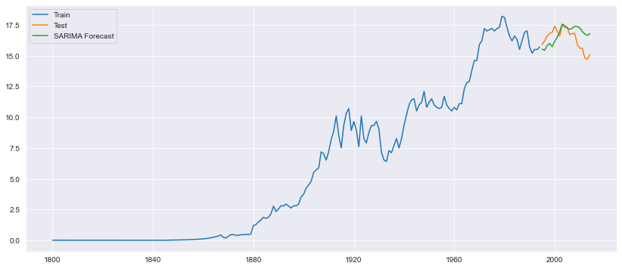
SARIMA Model Building on (Yearly Data)

Slide 29
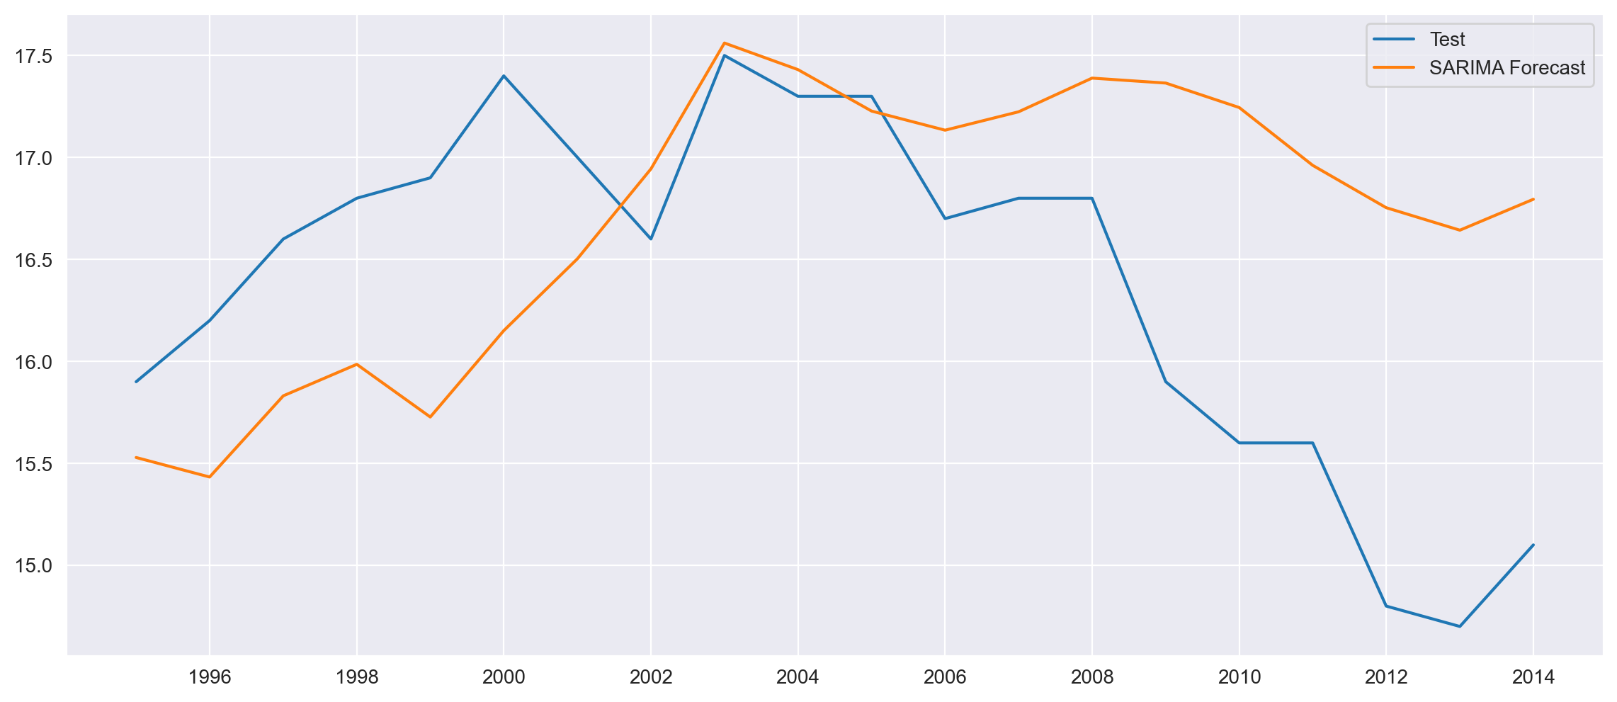
SARIMA Model Building on (Yearly Data)
Test Data vs Forecasted Data

Slide 30
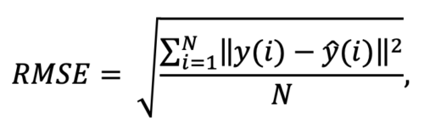
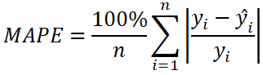
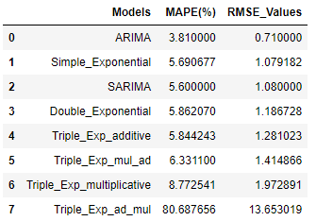
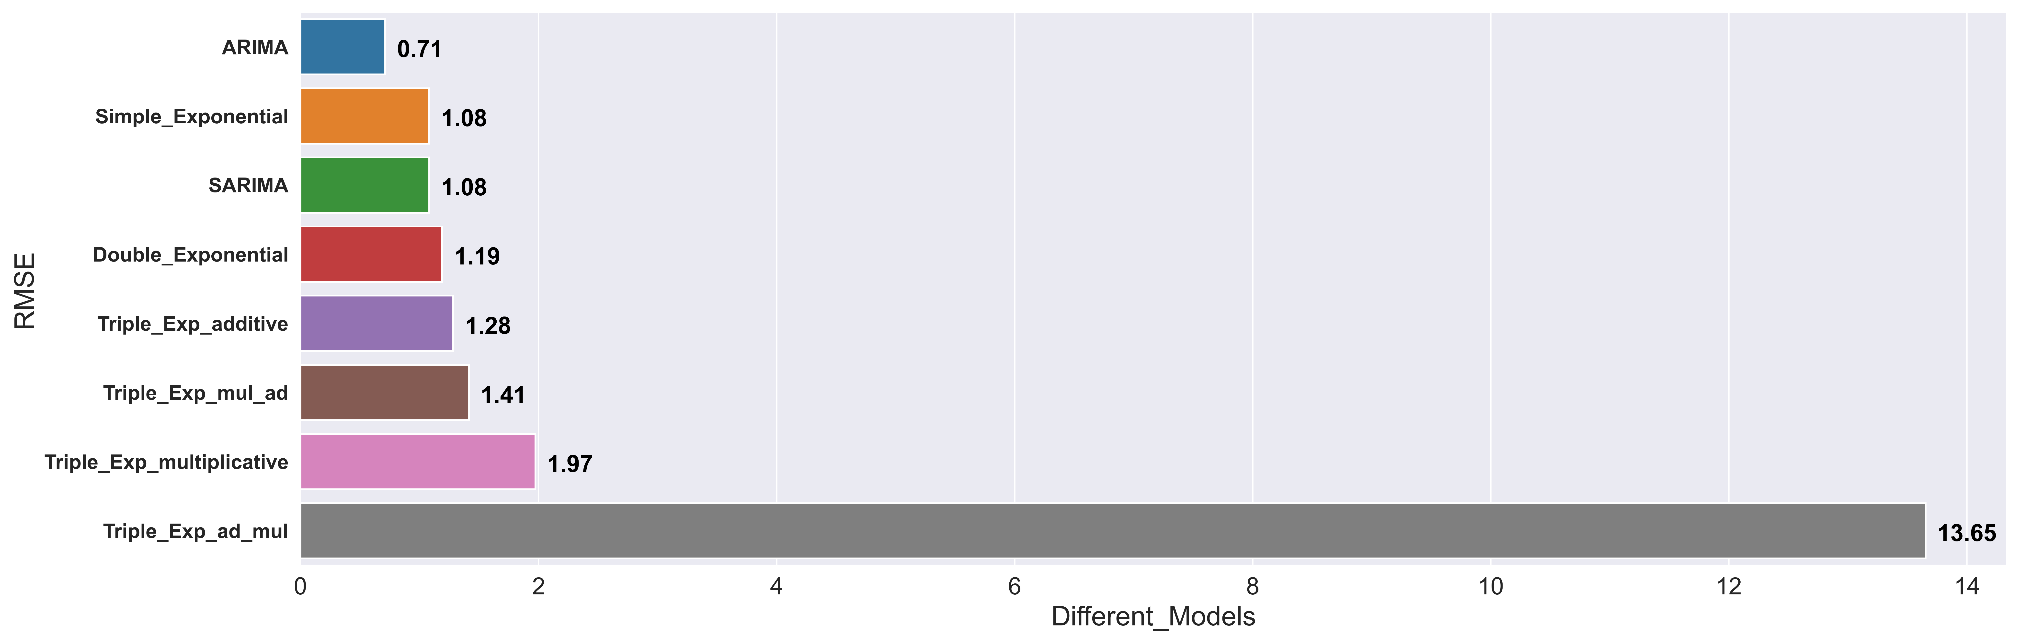
FINAL SCORES
ARIMA model performed well on Raw dataset
Error
Root Mean Square | Mean Absolute Percent

Slide 31
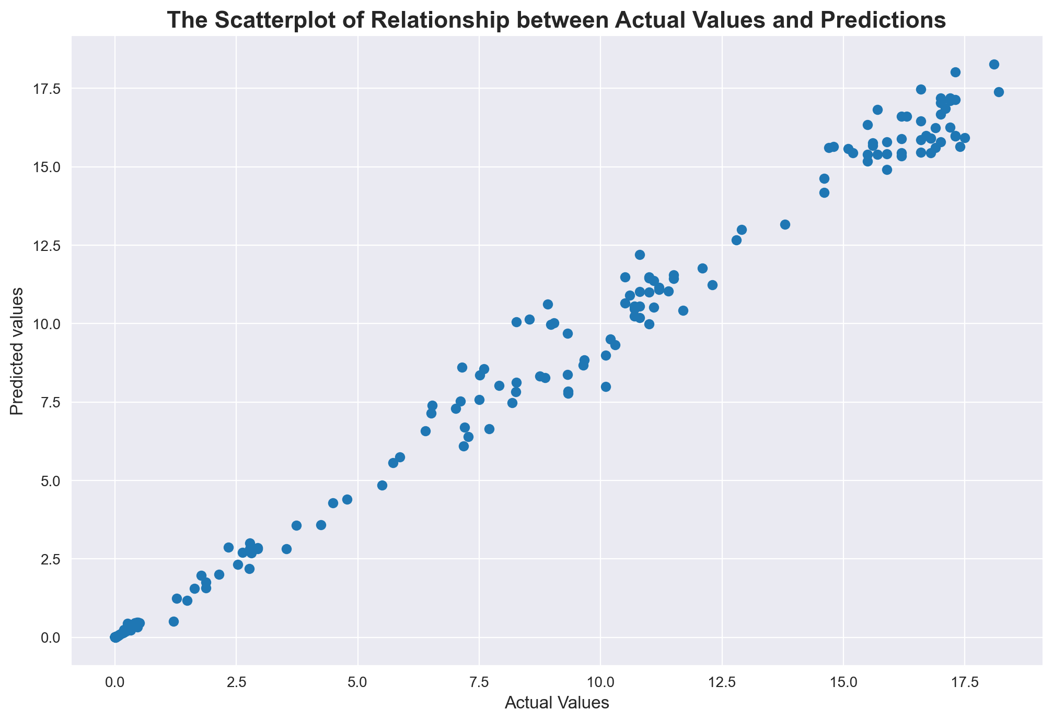
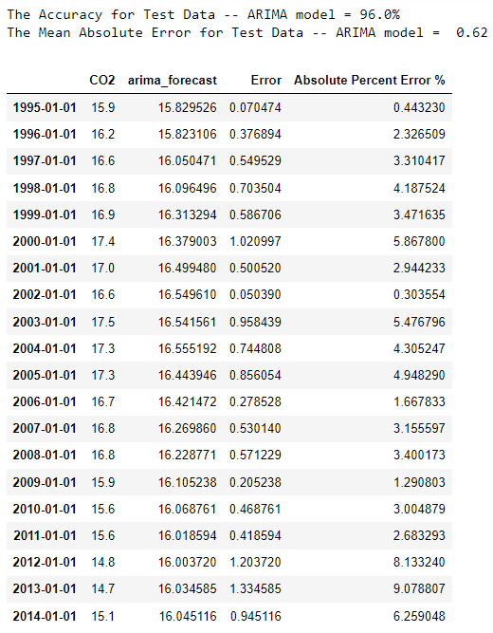
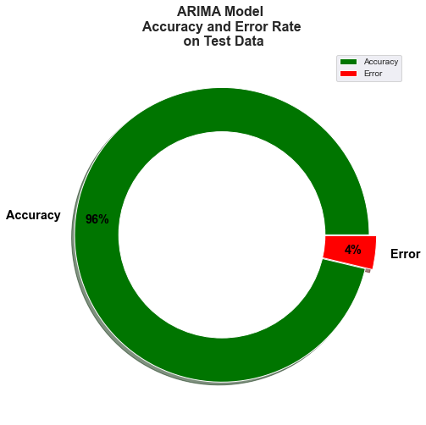
Evaluation and Prediction of the ARIMA Model
on Raw Dataset

Slide 32
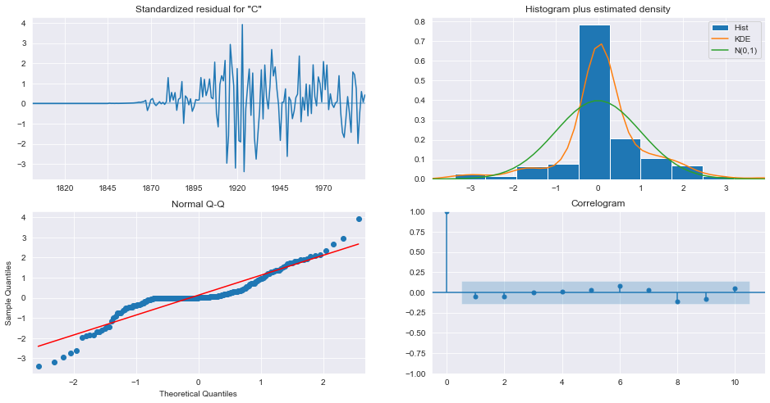
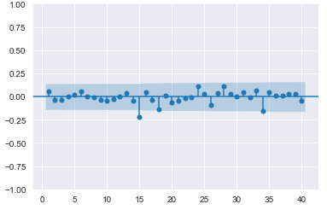
Evaluation of the ARIMA Model Errors

Slide 33
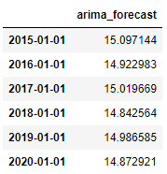
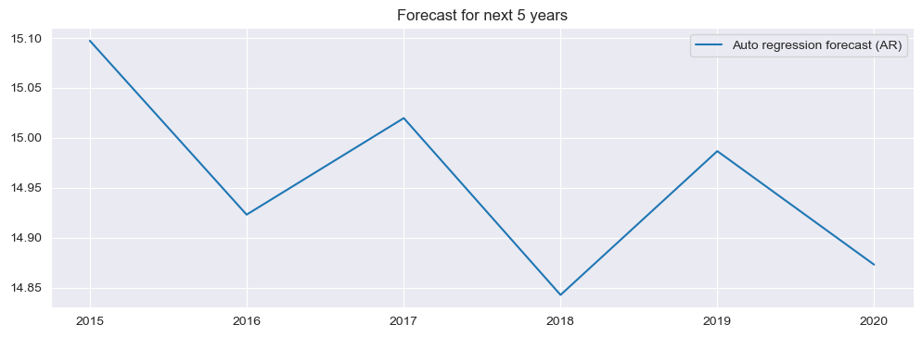
Forecasting for the Next 5 Years
Using the ARIMA Model on the Whole Dataset

Slide 34

Comparing Scores
Model building evaluation Score w.r.t RMSE and MAPE
Raw Dataset v/s Resampled Dataset

Slide 35


Splitting the resampled time series into train test split
No random partition That’s because the order sequence of the time series should be intact in order to use it for forecasting.
Leaving Test Data with 5 Years of Time Series
For training and testing We are going to forecast for the last 5 years. that is from 2010 to 2014.

Slide 36


Evaluation on Resampled Data (Monthly Data)

Slide 37



Evaluation and Prediction of the ARIMA Model
On Resampled Time Series

Slide 38

MODEL DEPLOYMENT
(Streamlit)

Slide 39

MODEL DEPLOYMENT
(Streamlit)

Slide 40

MODEL DEPLOYMENT
(Streamlit)

Slide 41

MODEL DEPLOYMENT
(Streamlit)

Slide 42
Problems faced
The data is positive skewed, platykurtic and doesn't follow normal distribution
The time series doesn’t have a linear trend
The time series doesn’t have additive or multiplicative seasonality
The time series is cyclic in which has no fixed time interval neither long or short term so prediction or forecasting future values can be challenging
The time series has high fluctuation and randomness, there is no gradual increase or any repeatable pattern
The time series doesn’t have Yearly , Quarterly or Monthly Seasonality
Methods and algorithms used captures seasonality and trend But the unexpected event occurs dynamically so capturing this becomes very difficult.
Irregularity in time series in which random variations are not purely with respect to time but due to other factors, which could be pandemic, wars, deforestation as well as the burning of fossil fuels like coal, oil and natural gas, etc. which influences in high fluctuation in emission of CO2.

Slide 43


